Slide 1
Chapter 11 Analysis of Variance
Copyright © 2022 McGraw Hill. All rights reserved. No reproduction or distribution without the prior written consent of McGraw Hill.
1-1

Slide 2
Chapter Learning Objectives
Chapter 11
LO11-1: Use basic ANOVA terminology correctly.
LO11-2: Explain the assumptions of ANOVA and why they are important.
LO11-3: Recognize from data format when one-factor ANOVA is appropriate.
LO11-4: Interpret sums of squares and calculations in an ANOVA table.
LO11-5: Use Excel or other software for ANOVA calculations.
LO11-6: Use a table or Excel to find critical values for the F distribution.
LO11-7: Understand and perform Tukey’s test for paired means.
LO11-8: Use Hartley’s test for equal variances in c treatment groups.
LO11-9: Recognize from data format when two-factor ANOVA is needed.
LO11-10: Interpret results in a two-factor ANOVA without replication.
LO11-11: Interpret main effects and interaction effects in two-factor ANOVA.
LO11-12: Recognize the need for experimental design and GLM (optional).

Slide 3
Overview of ANOVA
Chapter 11
Comparing more than two means simultaneously and tracing sources of variation to potential explanatory factors we use analysis of variance (commonly referred to as ANOVA).
Originally developed in connection with agricultural research (factors affecting crop growth), it was quickly applied in biology and medicine.
Because of its versatility, it is now used in engineering, psychology, marketing, and many other areas.

Slide 4
Variation
LO 11-4
Analysis of variance seeks to identify sources of variation in a numerical dependent variable Y (the response variable).
Variation in the response variable about its mean either is explained by one or more categorical independent variables (the factors) or is unexplained (random error):

Slide 5
Variation
LO 11-1
Each possible value of a factor or combination of factors is a treatment.
We test to see if each factor has a significant effect on Y using (for example) the hypotheses:
H₀: μ1 = μ2 = μ3 = μ4
H₁: Not all the means are equal.
The test uses the F distribution.
If we cannot reject H₀, we conclude that observations within each treatment have a common mean μ.

Slide 6
Illustration: Manufacturing Defect Rates
LO 11-1
The figure on the next slide shows a dot plot of daily defect rates for automotive computer chips manufactured at four plant locations. Samples of 10 days’ production were taken at each plant.
Are the observed differences in the plants’ sample mean defect rates merely due to random variation?
Or are the observed differences between the plants’ defect rates too great to be attributed to chance?
This is the kind of question that one-factor ANOVA is designed to answer.

Slide 7
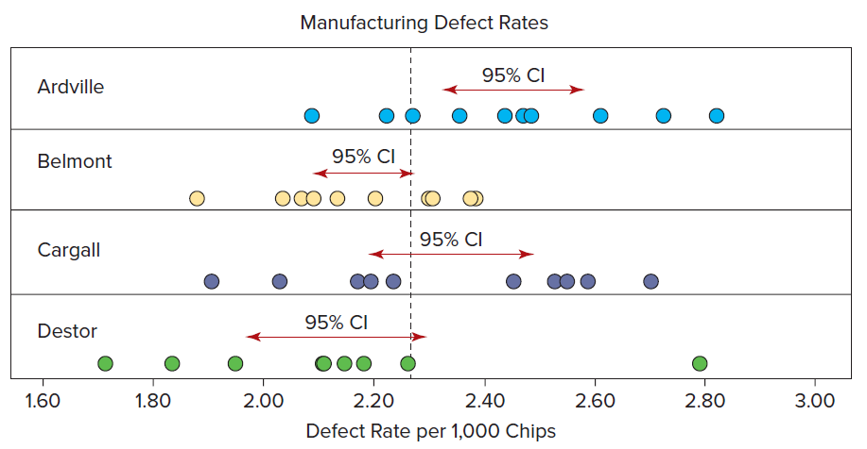
Illustration: Manufacturing Defect Rates
LO 11-1
A simple way to state the one-factor ANOVA hypothesis is
H₀: μ₁ = μ₂ = μ₃ = μ₄ (mean defect rates are the same at all four plants)
H₁: Not all the means are equal (at least one mean differs from the others)

Slide 8
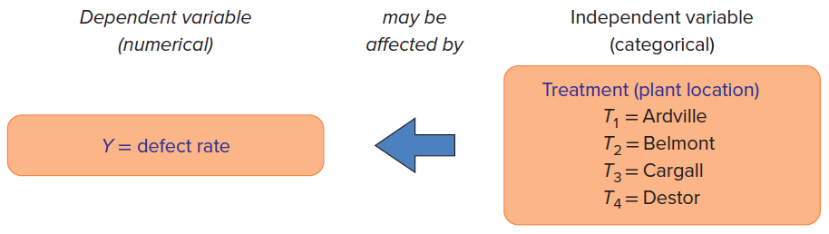
Illustration: Manufacturing Defect Rates
LO 11-1
If we cannot reject H₀, then we conclude that the observations within each treatment or group actually have a common mean μ (represented by the dashed line).
This one-factor ANOVA model may be visualized below.

Slide 9
ANOVA Assumptions
LO 11-2
Analysis of variance assumes that the
Observations on Y are independent.
Populations being sampled are normal.
Populations being sampled have equal variances.
Fortunately, ANOVA is somewhat robust to departures from the normality and equal variance assumptions.

Slide 10
ANOVA Calculations
LO 11-2
Software (e.g., Excel, MegaStat, MINITAB, SPSS) can be used to analyze data because computations are tedious.
Large samples increase the power of the test, but power also depends on the degree of variation in Y.
Lowest power would be in a small sample with high variation in Y.

Slide 11
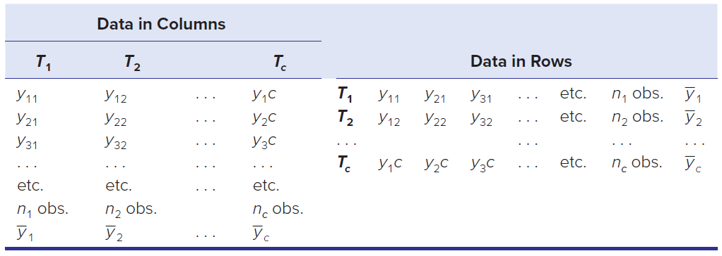
One-Factor ANOVA
LO 11-3
A one-factor ANOVA only compares the means of c groups (treatments or factor levels).
The one-factor ANOVA is usually viewed as a comparison between several columns of data, although the data also could be presented in rows.

Slide 12
One-Factor ANOVA
LO 11-3
Sample sizes within each treatment do not need to be equal (i.e., balanced).
The total number of observations is equal to n = n₁ + n₂ + … + n_{c}
The question of interest is whether the mean of Y varies from treatment to treatment. The hypotheses to be tested are
H0: μ₁ = μ₂ = . . . = μ_{c} (all the treatment means are equal)
H1: Not all the means are equal (at least one pair of treatment means differs)

Slide 13
One-Factor ANOVA as a Linear Model
LO 11-3
An equivalent way to express the one-factor model is to say that treatment j came from a population with a common mean (μ) plus a treatment effect (T_{j}) plus random error (ε_{ij}):
y_{ij} = μ + T_{j} + ε_{ij}
j = 1, 2, …, c
i = 1, 2, …, n
Random error is assumed to be normally distributed with zero mean and the same variance for all treatments.

Slide 14
One-Factor ANOVA as a Linear Model
LO 11-3
A fixed effects model only looks at what happens to the response for particular levels of the factor. H₀: T₁ = T₂ = … = T_{c} = 0 H₁: Not all T_{j} are zero
If the H₀ is true, then the ANOVA model collapses to y_{ij} = μ + ε_{ij}

Slide 15


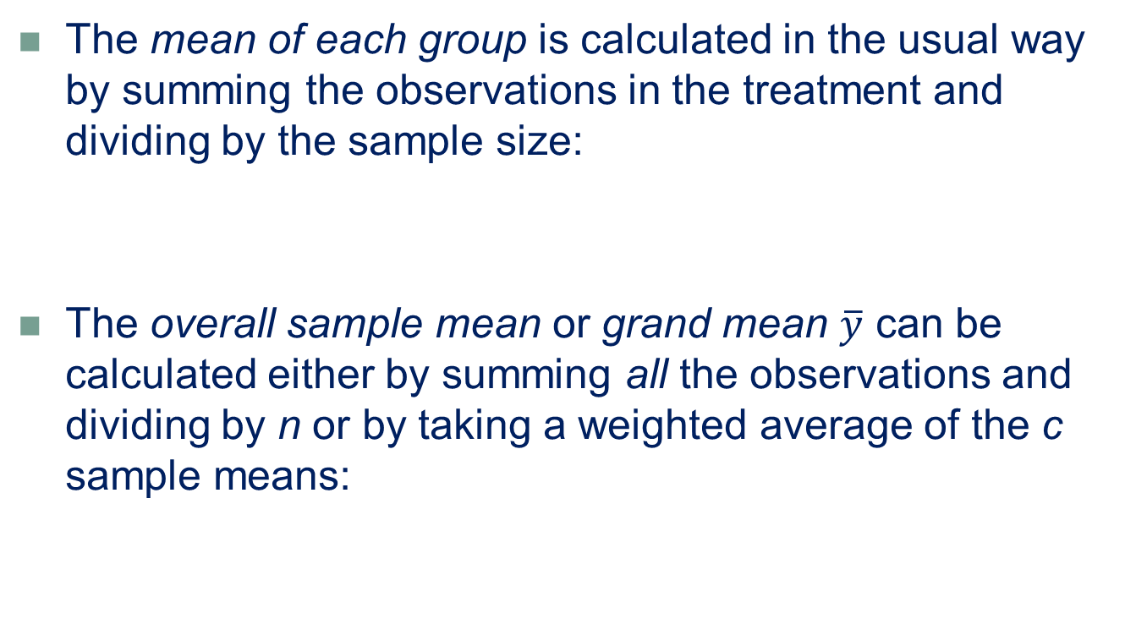
Group Means
LO 11-3
The mean of each group is calculated in the usual way by summing the observations in the treatment and dividing by the sample size:
The overall sample mean or grand mean $\overline{y}$ can be calculated either by summing all the observations and dividing by n or by taking a weighted average of the c sample means:

Slide 16

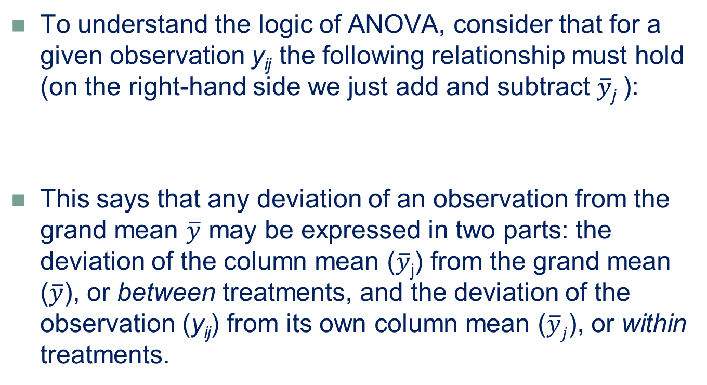
Partitioned Sum of Squares
LO 11-4
To understand the logic of ANOVA, consider that for a given observation y_{ij} the following relationship must hold (on the right-hand side we just add and subtract $\overline{y}$_{j} ):
This says that any deviation of an observation from the grand mean $\overline{y}$ may be expressed in two parts: the deviation of the column mean ($\overline{y}$_{j}) from the grand mean ($\overline{y}$), or between treatments, and the deviation of the observation (y_{ij}) from its own column mean ($\overline{y}j$), or within treatments.

Slide 17


Partitioned Sum of Squares
LO 11-4
We can show that this relationship also holds for sums of squared deviations, yielding the partitioned sum of squares:
This important relationship may be expressed simply as

Slide 18
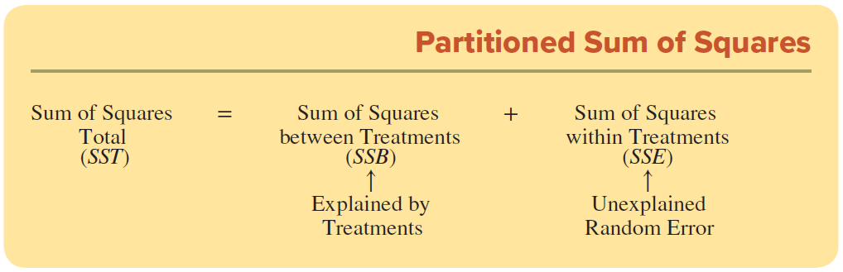
Partitioned Sum of Squares
LO 11-4
If the treatment means do not differ greatly from the grand mean, SSB will be relatively small and SSE will be relatively large (and conversely).
The sums SSB and SSE may be used to test the hypothesis that the treatment means differ from the grand mean.
However, we first divide each sum of squares by its degrees of freedom (to adjust for group sizes).
The F test statistic is the ratio of the resulting mean squares.

Slide 19
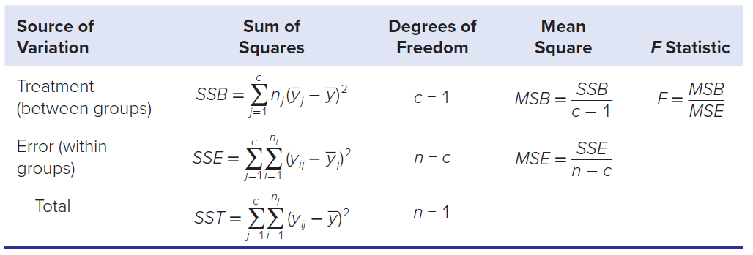
Partitioned Sum of Squares
LO 11-5
The ANOVA calculations are mathematically simple but involve tedious sums. These calculations are almost always done on a computer. For example, Excel’s one-factor ANOVA menu using Data Analysis.

Slide 20
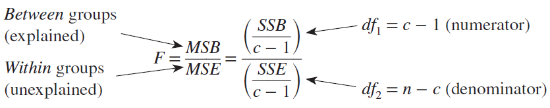
Test Statistic
LO 11-5
The ANOVA test statistic is an F test statistic.
The F distribution describes the ratio of two variances.
The F statistic is the ratio of the variance due to treatments (MSB) to the variance due to error (MSE).
When F is near zero, then there is little difference among treatments and we would not expect to reject the null hypothesis of equal treatment means.

Slide 21
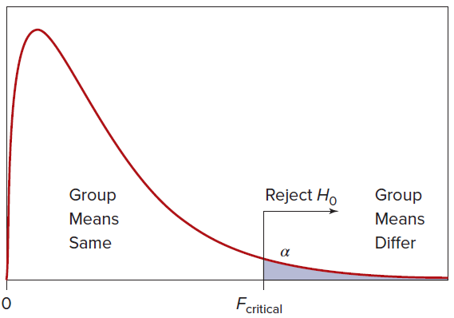
Decision Rule
LO 11-5
F cannot be negative and has no upper limit.
For ANOVA, the F test is a right-tailed test.
Use Appendix F or Excel (or other appropriate software) to obtain the critical value of F for a given α.

Slide 22
Example: Carton Packing
LO 11-5
A cosmetics manufacturer’s regional distribution center has four workstations that are responsible for packing cartons for shipment to small retailers. Each workstation is staffed by two workers. The task involves assembling each order, placing it in a shipping carton, inserting packing material, taping the carton, and placing a computer-generated shipping label on each carton. Generally, each station can pack 200 cartons a day, and often more. However, there is variability due to differences in orders, labels, and workers. The table on the next slide shows the number of cartons packed per day for the past 5 days.
Is the variation among stations within the range attributable to chance, or do these samples indicate actual differences in the station means?

Slide 23
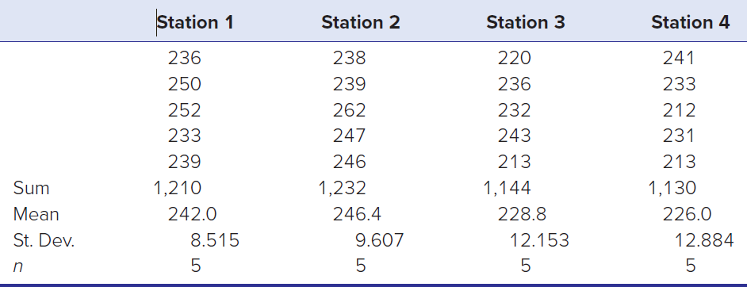
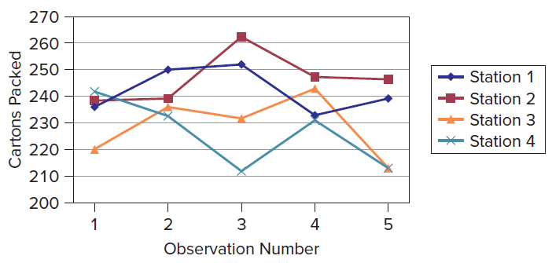
Example: Carton Packing
LO 11-5
As a preliminary step, we plot the data to check for any time pattern and just to visualize the data. We see some potential differences in means but no obvious time pattern.

Slide 24


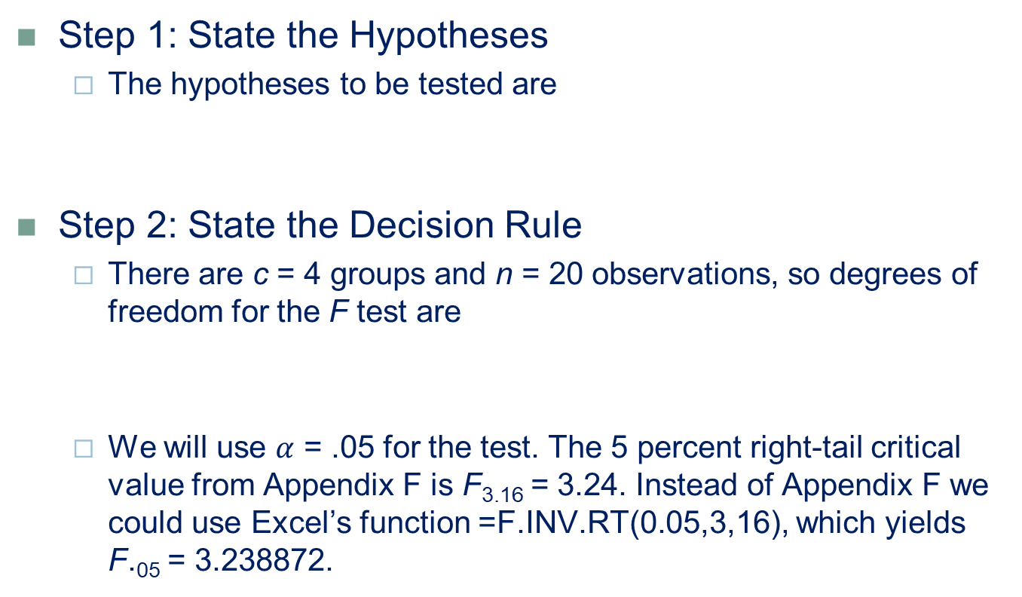
Example: Carton Packing
LO 11-6
Step 1: State the Hypotheses
The hypotheses to be tested are
Step 2: State the Decision Rule
There are c = 4 groups and n = 20 observations, so degrees of freedom for the F test are
We will use $α$ = .05 for the test. The 5 percent right-tail critical value from Appendix F is F_{3.16} = 3.24. Instead of Appendix F we could use Excel’s function =F.INV.RT(0.05,3,16), which yields F.₀₅ = 3.238872.

Slide 25
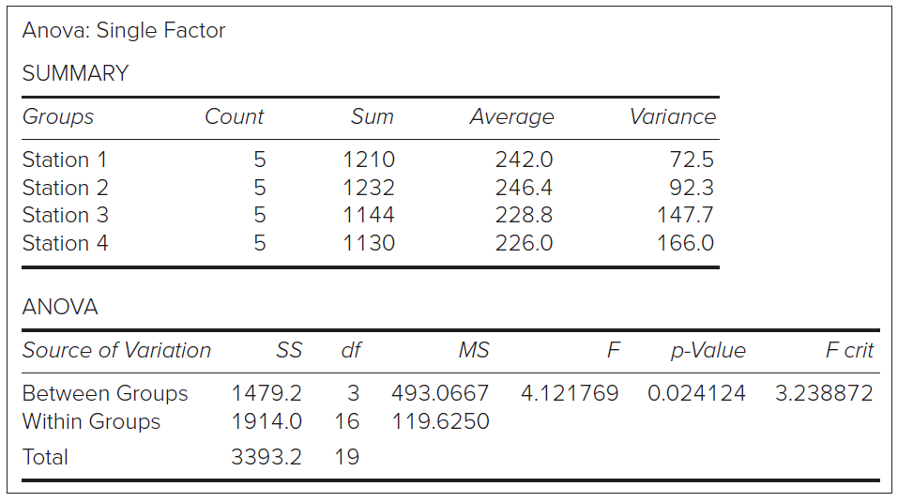
Example: Carton Packing
LO 11-6
Step 3: Perform the Calculations
Using Excel for the calculations, we obtain the results shown. You can specify the desired level of significance. Excel’s default is α = .05. Note that Excel labels SSB “between groups” and SSE “within groups.” This is an intuitive and attractive way to describe the variation.

Slide 26
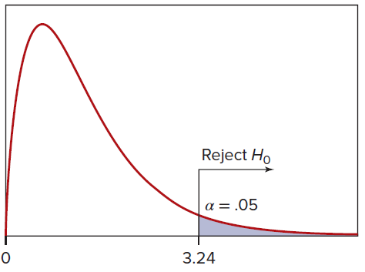
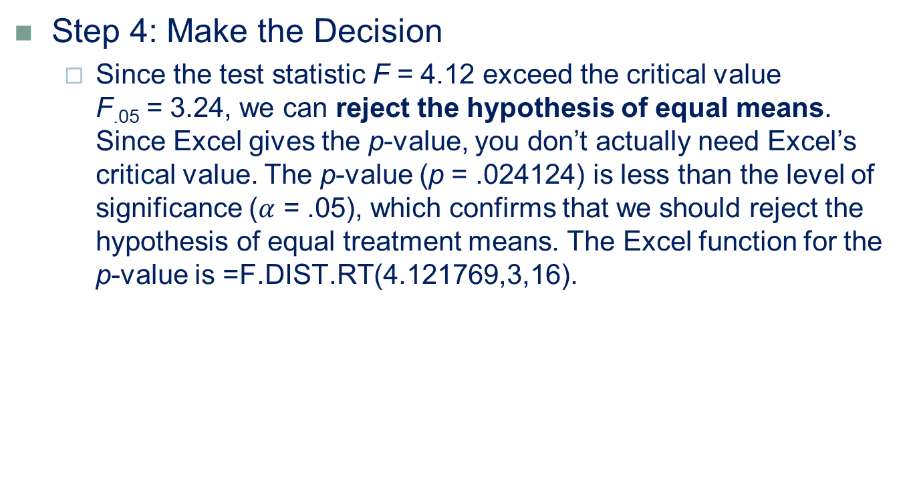
Example: Carton Packing
LO 11-6
Step 4: Make the Decision
Since the test statistic F = 4.12 exceed the critical value F_{.05} = 3.24, we can reject the hypothesis of equal means. Since Excel gives the p-value, you don’t actually need Excel’s critical value. The p-value (p = .024124) is less than the level of significance ($α$ = .05), which confirms that we should reject the hypothesis of equal treatment means. The Excel function for the p-value is =F.DIST.RT(4.121769,3,16).
Test Statistic: F = 4.12
Reject H₀

Slide 27
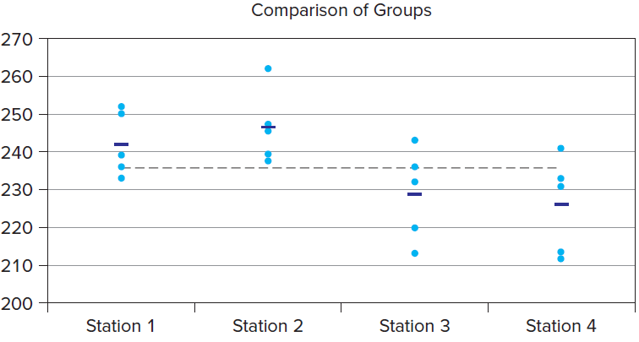
Example: Carton Packing
LO 11-6
Step 5: Take Action
As there is a significant difference in means, the distributor will undertake further analysis to see which stations are most efficient and identify possible reasons. The dot plot of observations by group, shown below, includes group means (shown as short horizontal tick marks) and the overall mean (shown as a dashed line). The dot plot suggests that stations 3 and 4 have means below the overall mean, while stations 1 and 2 are above the overall mean.

Slide 28
Tukey’s Test
LO 11-7
After rejecting the null hypothesis of equal mean, we naturally want to know: Which means differ significantly?
In order to maintain the desired overall probability of type I error, a simultaneous confidence interval for the difference of means must be obtained.
For c groups, there are c(c – 1)/2 distinct pairs of means to be compared.
These types of comparisons are called Multiple Comparison Tests.
We will just look at one called Tukey’s studentized range test (sometimes called HSD or “honestly significant difference” test).

Slide 29

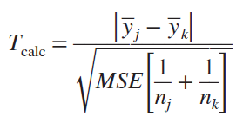
Tukey’s Test
LO 11-7
Tukey’s is a two-tailed test for equality of paired means from c groups compared simultaneously.
The hypotheses are:
Tukey’s test statistic is:

Slide 30
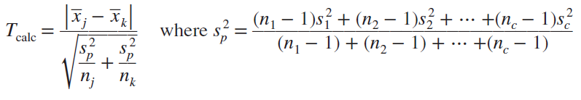
Tukey’s Test
LO 11-7
Note: If the desired degrees of freedom cannot be found, we could interpolate or rely on a computer package to provide the exact critical value. We take MSE directly from the ANOVA calculations (see Table 11.2 in the text).
The MSE is the pooled variance for all c samples combined (rather than pooling just two sample variances as in Chapter 10).
Therefore, Tukey’s test statistic also could be written as:

Slide 31
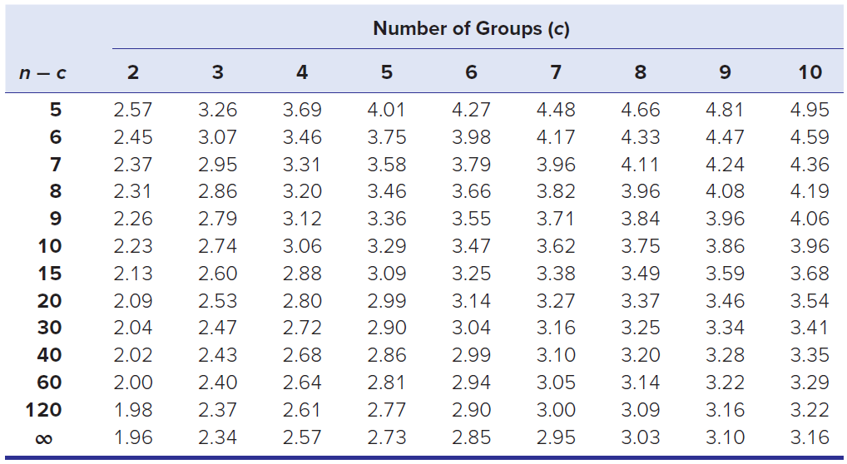
Tukey’s Test
LO 11-7
Five Percent Critical Values of Tukey Test Statistic

Slide 32
Tukey’s Test
LO 11-7
We use Tukey’s T test instead of comparing pairs of means using repeated independent t tests (Chapter 10).
Performing c independent t tests on the same data would increase our risk of finding a difference of means even if none exists in the population.
Tukey’s T test prevents this buildup of the Type I error probability.

Slide 33
ANOVA Assumptions
LO 11-8
Analysis of variance assumes that observations on the response variable are from normally distributed populations that have the same variance.
We can test the assumption of homogeneous (equal) variances.
Although the one-factor ANOVA test is only slightly affected by inequality of variance when group sizes are equal or nearly so, it is still a good idea to test this assumption.
One can test this assumption of homogeneous variances by using Hartley’s F_{max} Test.

Slide 34

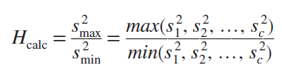
Hartley’s Test
LO 11-8
The hypotheses are:
Hartley’s test statistic is the ratio of the largest sample variance to the smallest sample variance:

Slide 35
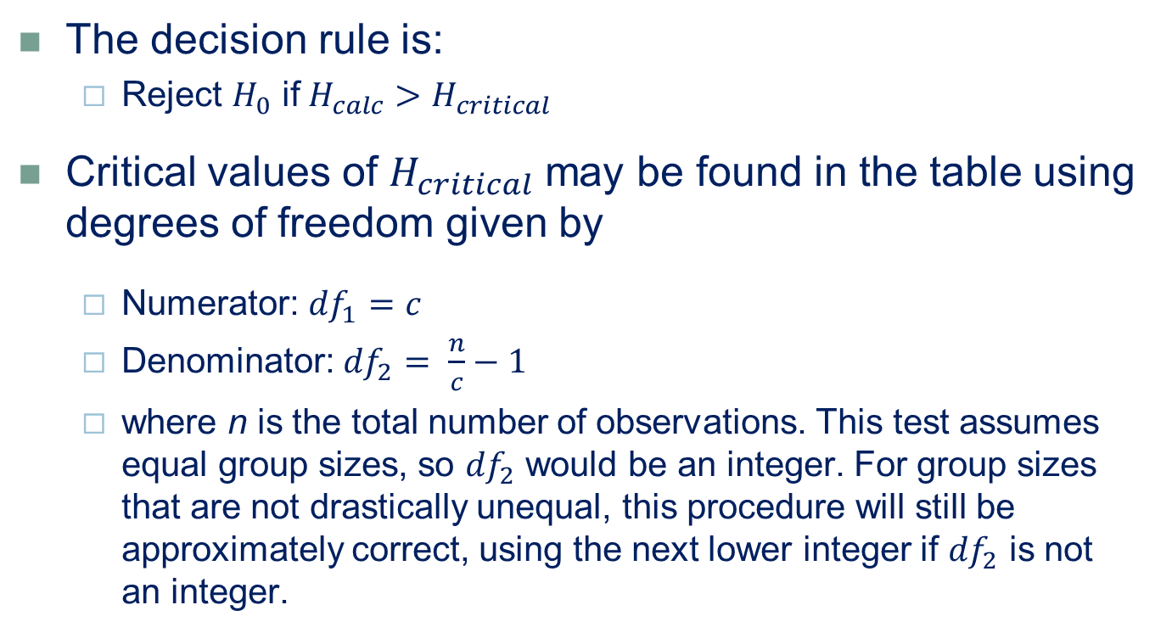
Hartley’s Test
LO 11-8
The decision rule is:
Reject $H_{0}$ if $H_{calc}>H_{critical}$
Critical values of $H_{critical}$ may be found in the table using degrees of freedom given by
Numerator: ${df}_{1}=c$
Denominator: ${df}_{2}= \frac{n}{c}−1$
where n is the total number of observations. This test assumes equal group sizes, so ${df}_{2}$ would be an integer. For group sizes that are not drastically unequal, this procedure will still be approximately correct, using the next lower integer if ${df}_{2}$ is not an integer.

Slide 36
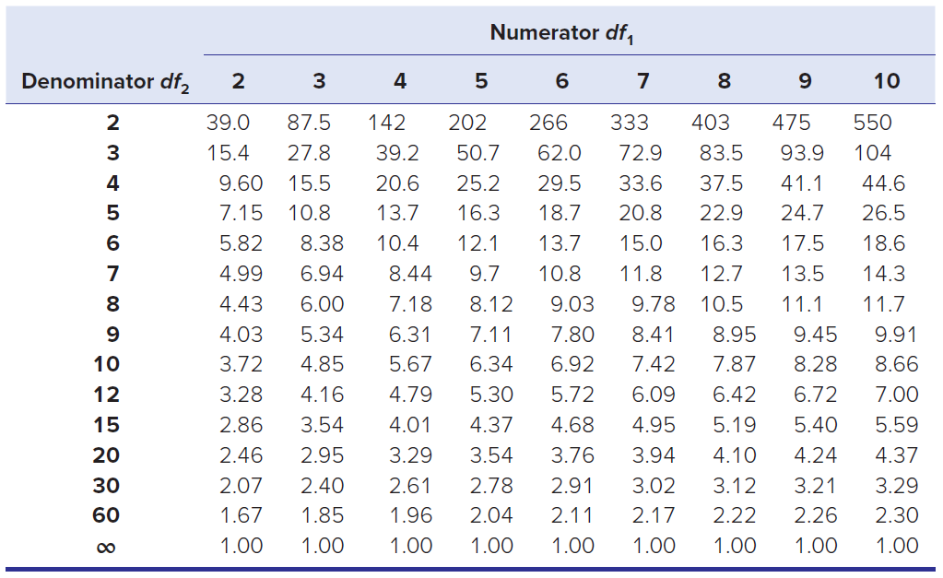

Hartley’s Test
LO 11-8
Critical 5 Percent Values of Hartley’s H = $s_{max}^{2}$ / $s_{min}^{2}$

Slide 37
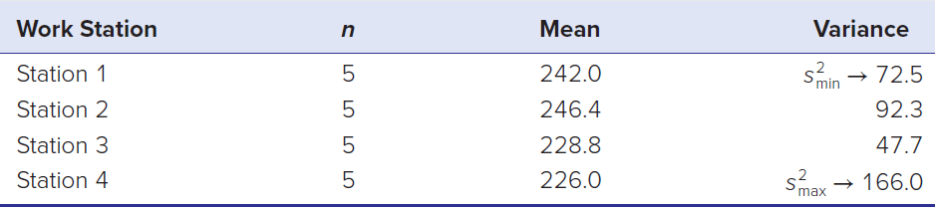
Example: Carton Packing
LO 11-8
Using the carton-packing data in Table 11.3, there are 4 groups and 20 total observations, so we have
Numerator: df₁ = c = 4
Denominator: df2 = n/c − 1 = 20/4 − 1 = 5 − 1 = 4
From the table we choose the critical value H_{critical} = 20.6 using df₁ = 4 and df₂ = 4. The sample statistics (from Excel) for our workstations are

Slide 38

Example: Carton Packing
LO 11-8
The test statistic is
In this case, we cannot reject the hypothesis of equal variances. Indeed, the table makes it clear that unless the sample size is very large, the variance ratio would have to be quite large to reject the hypothesis of equal population variances.

Slide 39
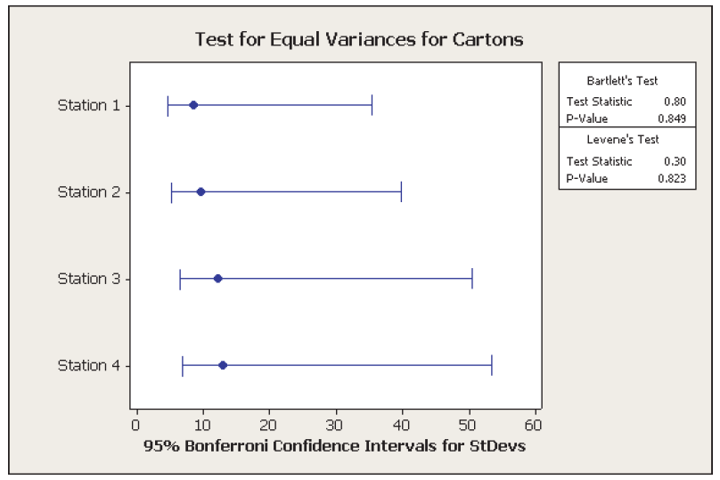
Levene’s Test
LO 11-8
Levene’s test is a more robust alternative to Hartley’s F test.
Levene’s test does not assume a normal distribution.
It is based on the distances of the observations from their sample medians rather than their sample means.
A computer program (e.g., MINITAB) is needed to perform this test.

Slide 40
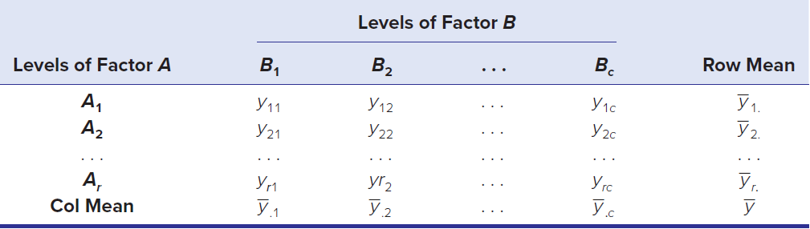
Two-Factor ANOVA Without Replication
LO 11-9
Suppose that two factors A and B may affect Y.
One way to visualize this is to imagine a data matrix with r rows and c columns. Each row is a level of factor A, while each column is a level of factor B. Initially, we will consider the case where all levels of both factors occur, and each cell contains only one observation.
In this two-factor ANOVA without replication (or nonrepeated measures design), each factor combination is observed exactly once.

Slide 41
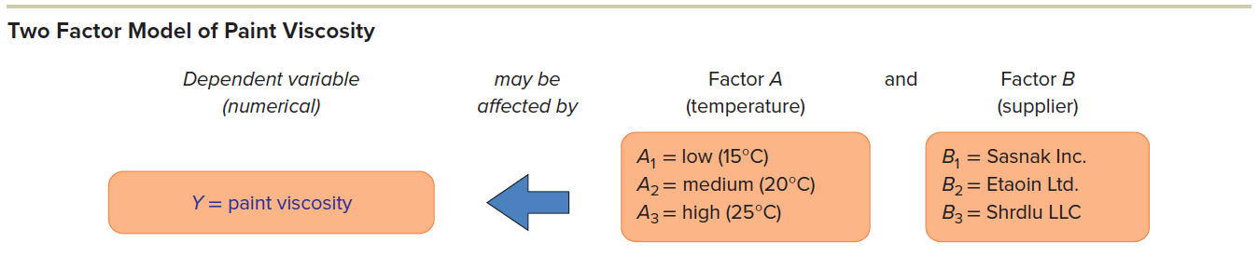
Two-Factor ANOVA Without Replication
LO 11-9
This figure illustrates a two-factor ANOVA model in which a numerical response variable (paint viscosity) may vary both by temperature (Factor A) and by paint supplier (Factor B). Three different temperature settings (A1, A2, A3) were tested on shipments from three different suppliers (B1, B2, B3), yielding a table with 3 × 3 = 9 cells.
Each factor combination is a treatment. With only one observation per treatment, no interaction between the two factors is included.

Slide 42

Two-Factor ANOVA Model
LO 11-9
Expressed in linear form, the two-factor ANOVA model is
Where
y_{jk} = observed data value in row j and column k
μ = common mean for all treatments
A_{j} = effect of row factor A (j = 1, 2, . . . , r)
B_{k} = effect of column factor B (k = 1, 2, . . ., c)
ε_{jk} = random error
The random error is assumed to be normally distributed with zero mean and the same variance for all treatments.

Slide 43


Hypotheses to Be Tested
LO 11-9
If we are interested only in what happens to the response for the particular levels of the factors that were selected (a fixed-effects model), then the hypotheses to be tested are
Factor A
Factor B

Slide 44
Randomized Black Model
LO 11-9
In the randomized block model, it is customary to call the column effects treatments (as in one-factor ANOVA to signify that they are the effect of interest), while the row effects are called blocks.
A randomized block model looks like a two-factor ANOVA and is computed exactly like a two-factor ANOVA.
However, its interpretation by the researcher may resemble a one-factor ANOVA because only the column effects (treatments) are of interest.
The blocks exist only to reduce variance.

Slide 45

Two-Factor ANOVA Without Replication
LO 11-10
The total sum of squares shown has three components:
Where
SST = total sum of squared deviations about the mean
SSA = between rows sum of squares (effect of factor A)
SSB = between columns sum of squares (effect of factor B)
SSE = error sum of squares (residual variation)
Calculations are almost always done by a computer.

Slide 46
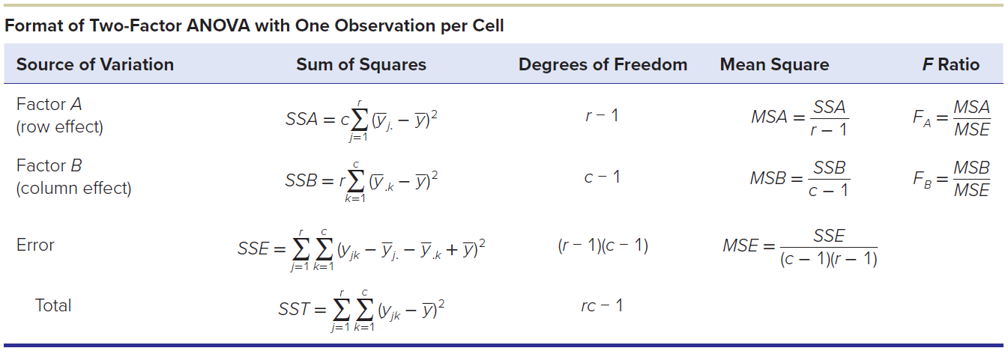
Two-Factor ANOVA Without Replication
LO 11-10

Slide 47
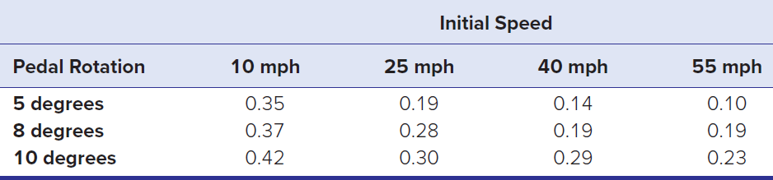
Example: Vehicle Acceleration
LO 11-10
A driver steps down on the vehicle accelerator pedal in order to speed up the vehicle. What is the peak acceleration to a final speed of 80 mph? Tests were carried out on one vehicle at four different initial speeds (10, 25, 40, and 55 mph) and three different levels of pedal rotation (5, 8, and 10 degrees). The acceleration results are shown in Table 11.10. Does this sample show that the two experimental factors (pedal rotation, initial speed) are significant predictors of acceleration? This is an unreplicated experiment.

Slide 48


Example: Vehicle Acceleration
LO 11-10
Step 1: State the Hypotheses
Factor A (PedalRotation)
Factor B (InitialSpeed)

Slide 49
Example: Vehicle Acceleration
LO 11-10
Step 2: State the Decision Rule
Each F test may require a different right-tail critical value because the numerator degrees of freedom depend on the number of factor levels, while denominator degrees of freedom (error SSE) are the same for all three tests:
Factor A: df₁ = r − 1 = 3 − 1 = 2 (r = 3 pedal rotations)
Factor B: df₁= c − 1 = 4 − 1 = 3 (c = 4 initial speeds)
Error: df₂ = (r − 1)(c − 1) = (3 − 1)(4 − 1) = 6
From Appendix F, the 5 percent critical values in a right-tailed test (all ANOVA tests are right-tailed tests) are
F_{2,6} = 5.14 for factor A
F_{3,6} = 4.76 for factor B
We will reject the null hypothesis (no factor effect) if the F test statistic exceeds the critical value.

Slide 50
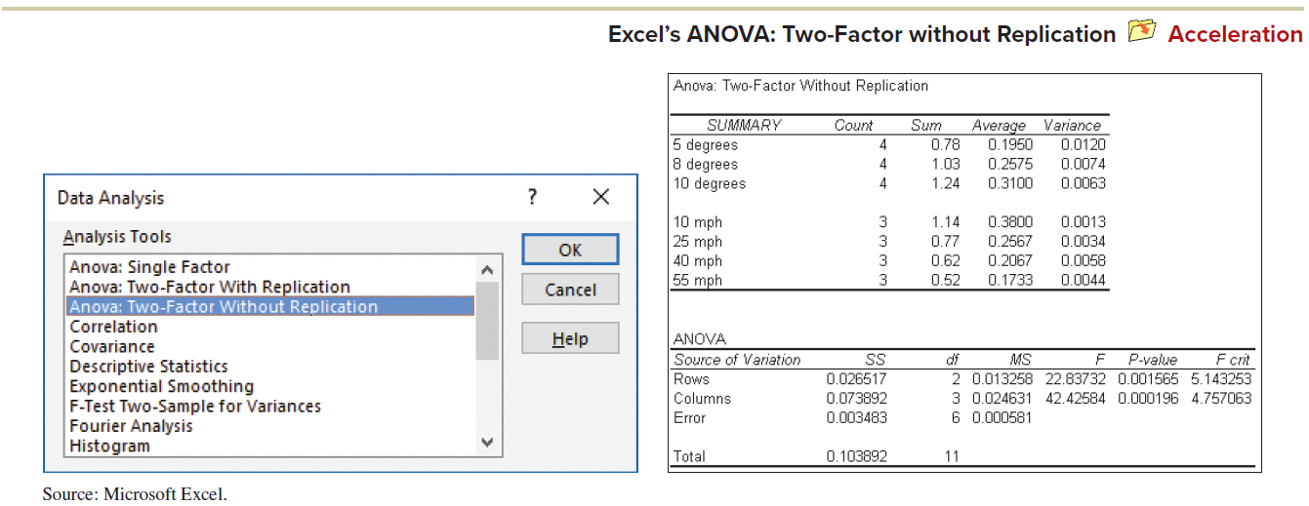
Example: Vehicle Acceleration
LO 11-10
Step 3: Perform the Calculations
Calculations are done by using Excel’s Data Analysis. The menu and results are shown. There is a table of means and variances, followed by the ANOVA table.

Slide 51
Example: Vehicle Acceleration
LO 11-10
Step 4: Make the Decision
Acceleration is significantly affected by pedal rotation (p = .001565).
Acceleration is significantly affected by initial speed (p = .000196).
Step 5: Take Action
The p-values suggest that initial speed is a more significant predictor than pedal rotation, although both are highly significant. Maximum acceleration from a low speed or standing stop is greater than when you are driving down the freeway, and, of course, the harder you press the accelerator pedal, the faster you will accelerate. In fact, you might think of the pedal rotation as a blocking factor because its relationship to acceleration is tautological and of little research interest.

Slide 52
Two-Factor ANOVA with Replication
LO 11-11
In a two-factor model, suppose that each factor combination is observed m times. With multiple observations within each cell, we can do more detailed statistical tests.
With an equal number of observations in each cell (balanced data), we have a two-factor ANOVA model with replication.
Replication allows us to test not only the factors’ main effects but also an interaction effect. This model is often called the full factorial model.

Slide 53

Two-Factor ANOVA with Replication
LO 11-11
In linear model format it may be written
Where
y_{ijk} = observation i for row j and column k (i = 1, 2, . . . , m)
μ = common mean for all treatments
Aj = effect attributed to factor A in row j (j = 1, 2, . . . , r)
B_{k} = effect attributed to factor B in column k (k = 1, 2, . . . , c)
AB_{jk} = effect attributed to interaction between factors A and B
ε_{ijk} = random error (normally distributed, zero mean, same variance for all treatments)

Slide 54



Two-Factor ANOVA with Replication
LO 11-11
For a fixed-effects ANOVA model, the hypotheses that could be tested in the two-factor ANOVA model with replicated observations are
Factor A (Row Effect)
Factor B (Column Effect)
Interaction Effect

Slide 55
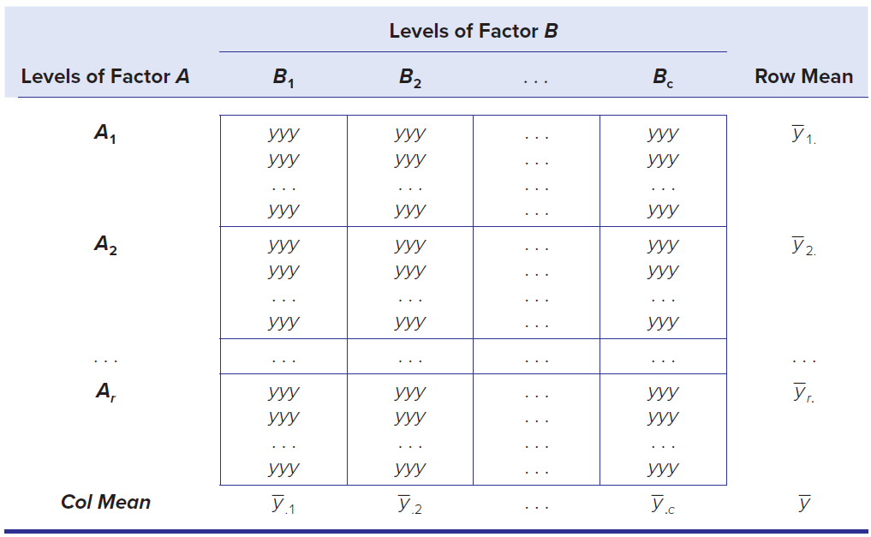
Format of Data
LO 11-11
The table shows the format of a data set with two factors and a balanced (equal) number of observations per treatment (each row/column intersection is a treatment).

Slide 56

Sources of Variation
LO 11-11
There are now three F tests that could be performed: one for each main effect (factors A and B) and a third F test for interaction. The total sum of squares is partitioned into four components:
Where
SST = total sum of squared deviations about the mean
SSA = between rows sum of squares (effect of factor A)
SSB = between columns sum of squares (effect of factor B)
SSI = interaction sum of squares (effect of AB)
SSE = error sum of squares (residual variation)
For an experiment with r rows, c columns, and m replications per treatment, the sums of squares and ANOVA calculations may be presented in a table.

Slide 57
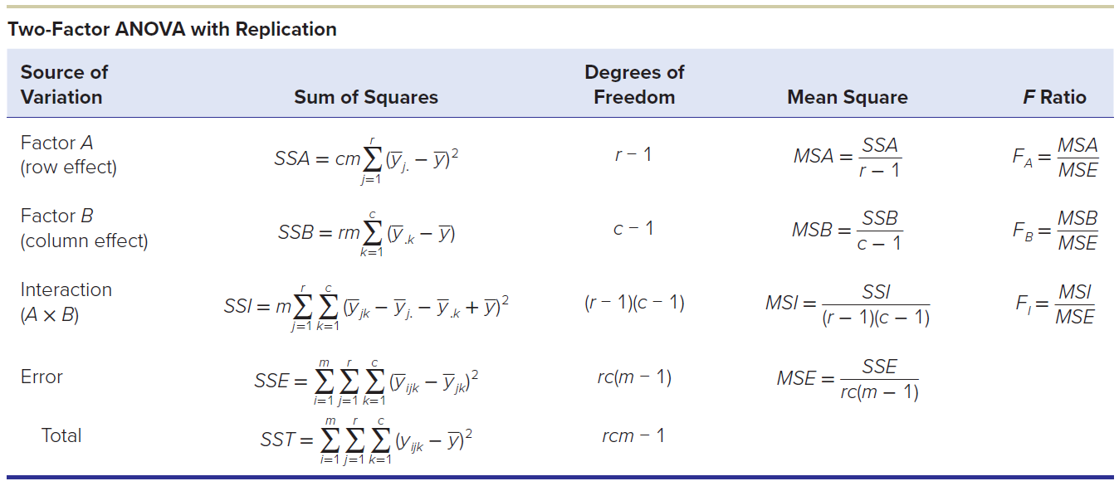
Two-Factor ANOVA with Replication
LO 11-11

Slide 58
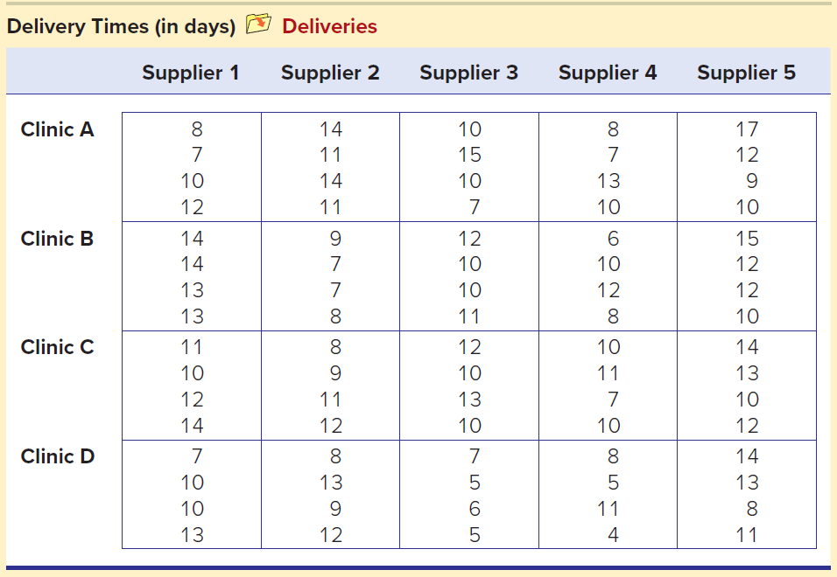
Example: Delivery Time
LO 11-11
A health maintenance organization orders weekly medical supplies for its four clinics from five different suppliers. Delivery times (in days) for 4 recent weeks are shown in the table. Do the means differ between clinics or suppliers? Is there interaction?

Slide 59



Example: Delivery Time
LO 11-11
Step 1: State the Hypotheses
The Hypotheses are
Factor A: Row Effect (Clinic)
Factor B: Column Effect (Supplier)
Interaction Effect (Clinic x Supplier)

Slide 60
Example: Delivery Time
LO 11-11
Step 2: State the Decision Rule
Denominator degrees of freedom
Factor A: df₁ = r − 1 = 4 − 1 = 3 (r = 4 clinics)
Factor B: df₁ = c − 1 = 5 − 1 = 4 (c = 5 suppliers)
Interaction (AB): df₁ = (r − 1)(c − 1) = (4 − 1)(5 − 1) = 12
Error: df₂ = rc(m − 1) = 4 × 5 × (4 − 1) = 60
Excel provides the right-tail F critical values for α = .05, which we can verify using Appendix F:
F_{3,60} = 2.76 for Factor A
F_{4,60} = 2.53 for Factor B
F_{12,60} = 1.92 for Factor AB
We reject the null hypothesis if an F test statistic exceeds its critical value.

Slide 61
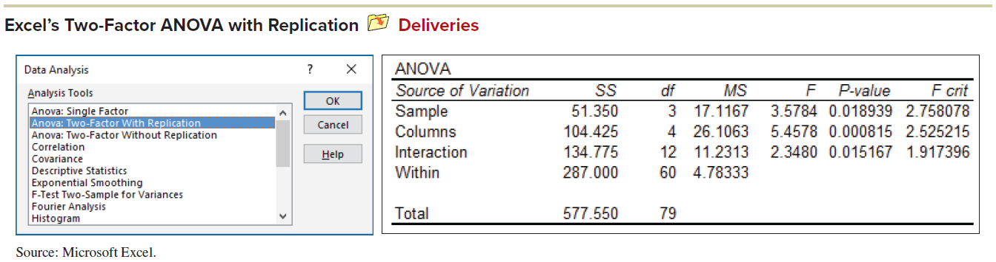
Example: Delivery Time
LO 11-11
Step 3: Perform the Calculations
Excel provides tables of row and column sums and means.

Slide 62
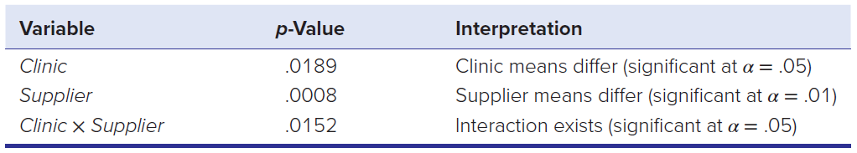
Example: Delivery Time
LO 11-11
Step 4: Make the Decision
For the row variable (Clinic), the test statistic F = 3.578 and its p-value (p = .0189) lead us to conclude that the mean delivery times among clinics are not the same at α = .05.
For the column variable (Supplier), the test statistic F = 5.458 and its p-value (p = .0008) lead us to conclude that the mean delivery times from suppliers are not the same at α = .05.
For the interaction effect, the test statistic F = 2.348 and its p-value (p = .0152) indicate significance at α = .05.

Slide 63
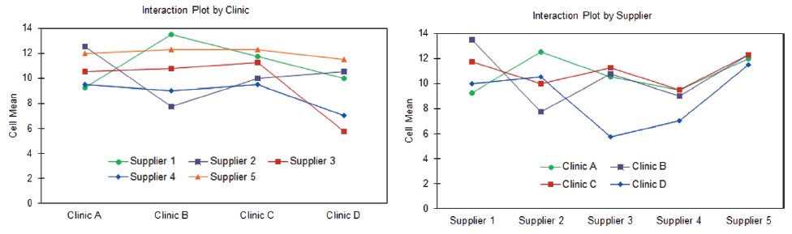
Interaction
LO 11-11
To visualize an interaction, we plot the treatment means for one factor against the levels of the other factor.
Within each factor level, we connect the means.
In the absence of an interaction, the lines will be roughly parallel or will tend to move in the same direction at the same time.
If there is a strong interaction, the lines will have differing slopes and will tend to cross one another.

Slide 64
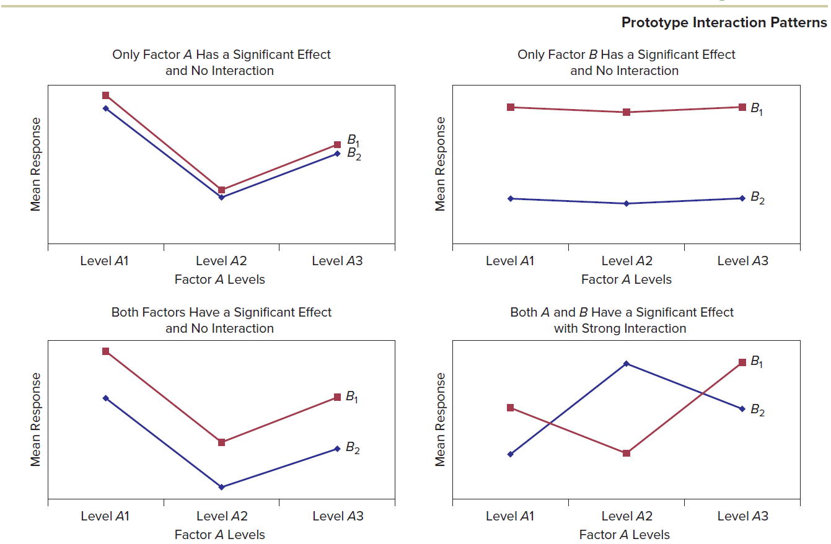
Interaction Patterns
LO 11-11

Slide 65
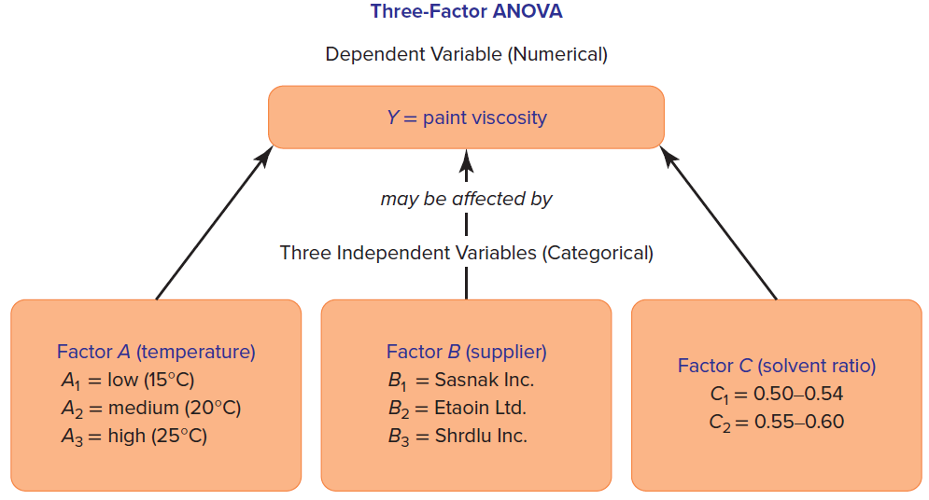
Higher-Order ANOVA Models
LO 11-12
A three-factor ANOVA allows more two-factor interactions (A × B, A × C, B × C) and even a three-factor interaction (A × B × C).
Higher-order ANOVA models are beyond Excel’s capabilities, so you will need fancier software.

Slide 66
General Linear Model
LO 11-12
The general linear model (GLM) is a versatile tool for estimating large and complex ANOVA models.
Besides allowing more than two factors, GLM permits unbalanced data (unequal sample size within treatments) and any desired subset of interactions among factors (including three-way interactions or higher) as long as you have enough observations (i.e., enough degrees of freedom) to compute the effects.
GLM also can provide predictions and identify unusual observations.

Slide 67
Experimental Design
LO 11-12
Experimental design refers to the number of factors under investigation, the number of levels assigned to each factor, the way factor levels are defined, and the way observations are obtained.
Fractional factorial designs, for reasons of economy, limit data collection to a subset of possible factor combinations.
If all levels of one factor are fully contained in another, the design is nested or hierarchical.
Balanced designs are characterized by an equal number of observations for each factor combination.

Slide 68
Experimental Design
LO 11-12
2^{k} Models
When there are k factors, each with two levels, we have a 2^{k} factorial design. Reducing a factor to two levels is a useful simplification that reduces the data requirements in a replicated experiment because the data matrix will have fewer cells.
Fractional Factorial Designs
Fractional factorial design, for reasons of economy, limits data collection to a subset of the possible factor combinations.
Nested or Hierarchical Design
If all levels of one factor are fully contained within another, the design is nested or hierarchical.
Random Effects Models
In a random effects model, the factor levels are chosen randomly from a population of potential factor levels.

Slide 69
Chapter 11 Practice Problems

Slide 70
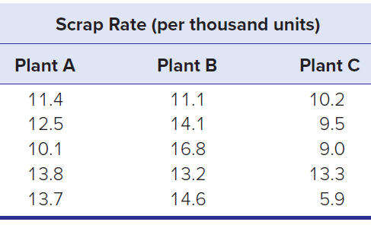
Question 5
LO 11-5, 6
Scrap rates per thousand (parts whose defects cannot be reworked) are compared for five randomly selected days at three plants. Do the data show a significant difference in mean scrap rates? Using α = .05.
a. State the hypotheses.
b. What are the degrees of freedom for the test?
c. What is the critical value of F at the 5 percent level of significance?
d. State your conclusion about the population means.
e. Interpret the p-value.

Slide 71
Question 9
LO 11-7
Consider a one-factor ANOVA with n1 = 9, n2 = 10, n3 = 7, n4 = 8.
a. How many possible comparisons of means are there?
b. State the degrees of freedom for Tukey’s T.
c. Find the critical value of Tukey’s T for α = .05.

Slide 72
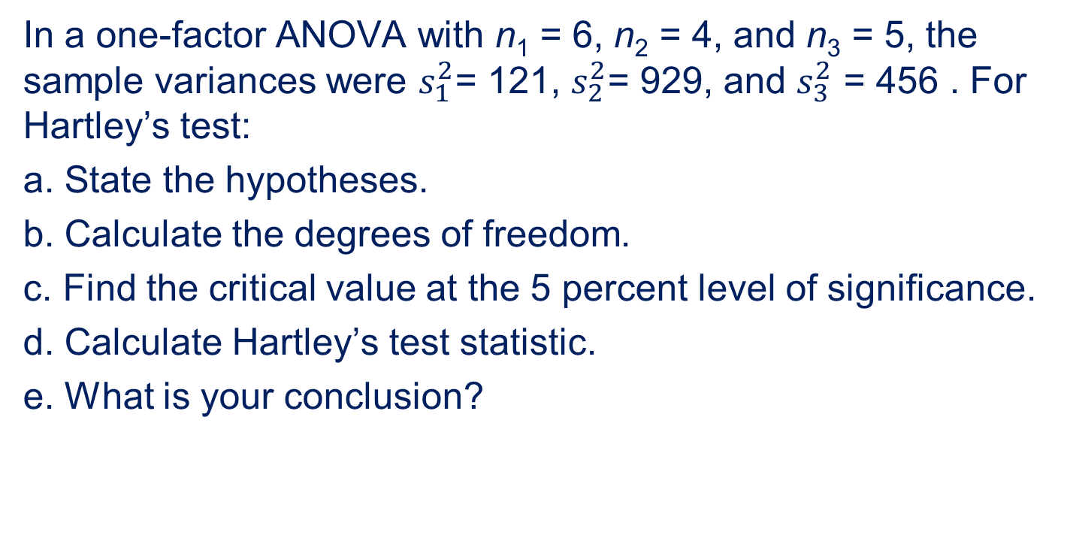
Question 15
LO 11-8
In a one-factor ANOVA with n₁ = 6, n₂ = 4, and n₃ = 5, the sample variances were $s_{1}^{2}$= 121, $s_{2}^{2}$= 929, and $s_{3}^{2}$ = 456 . For Hartley’s test:
a. State the hypotheses.
b. Calculate the degrees of freedom.
c. Find the critical value at the 5 percent level of significance.
d. Calculate Hartley’s test statistic.
e. What is your conclusion?

Slide 73
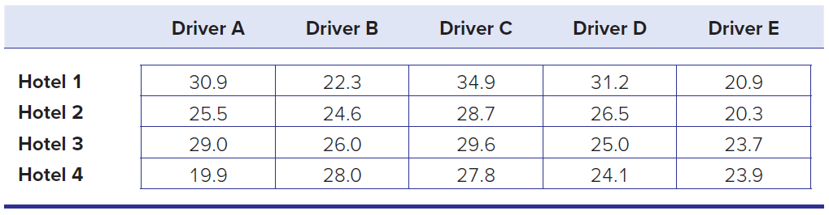
Question 23
LO 11-10
Driving time (minutes) from the airport to each of four downtown hotels is recorded for five Uber drivers. Does this sample provide sufficient evidence to conclude that there is a significant difference in treatment means? α = .05
a. State the hypotheses. If you are viewing this data set as a randomized block, which is the blocking factor, and why?
b. State your conclusions about the treatment means.
c. Interpret the p-values carefully.

Slide 74
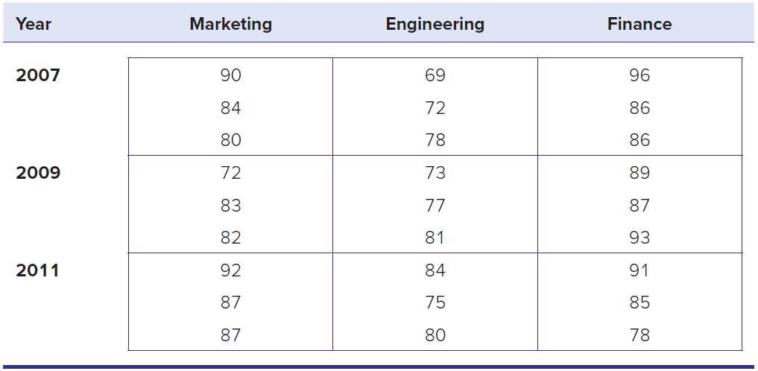
Question 26
LO 11-11
Oxnard Petro, Ltd., has three interdisciplinary project development teams that function on an ongoing basis. Team members rotate from time to time. Every 4 months (three times a year) each department head rates the performance of each project team (using a 0–100 scale, where 100 is the best rating). Are the main effects significant? Is there an interaction?
a. State the hypotheses.
b. Use Excel’s Data Analysis (or other software) to perform the two-factor ANOVA with replication, using α = .05.
c. State your conclusions about the main effects and interaction effects.
d. Interpret the p-values carefully.

Slide 75
Chapter 11 Analytics in Action

Slide 76


